Slide 1
第二讲：方差分析

Slide 2
Analysis of variance
Analysis of variance is the term used for statistical methods for comparing means of groups of continuous observations where the groups are defined by the levels of factors.
In this case all the explanatory variables are categorical and all the elements of the design matrix X are dummy variables.

Slide 3
T test vs. ANOVA
Test | Number of groups
T test | Two
ANOVA | Multiple
T test 所要检验的零假设（H₀）是：
H₀：μ₁＝μ₂
ANOVA所要检验的零假设（H₀）是：
H₀：μ₁＝μ₂＝…＝μ_{L}

Slide 4
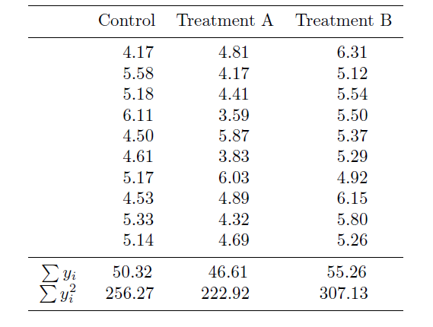
One factor analysis of variance
Example: weights of plants from three different growing conditions

Slide 5
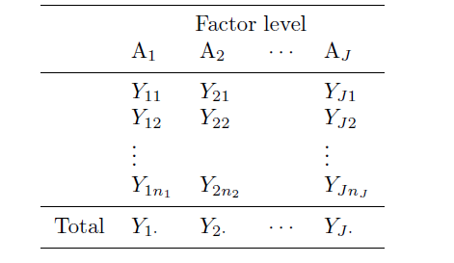
Generally, data from a completely randomized experiment with J levels of a factor A.
The responses at level j, Y_{j1}, . . . , Y_{jnj}, all have the same expected value and so they are called replicates. In general there may be different numbers of observations n_{j} at each level.

Slide 6

$n_{j}=K$
Suppose , for j=1,2, ..., J.
N=KJ.
Y= [Y₁₁, Y₁₂. . . , Y_{1K} , Y₂₁, Y₂₂. . . , Y_{2K} ,…, Y_{J1}, Y_{J2}. . . , Y_{JK} ]^{T}
We consider three different specifications of a model to test the hypothesis that the response means differ among the factor levels.

Slide 7


Model Specification for H₀
To test H₀: μ₁= μ₂ =…= μ_{J} vs. H₁: Not all the means are equal,
Model Specification of H₀
for j=1,…, J, k=1,…, K.
where, Y₁₁, Y₁₂. . . , Y_{1K} , Y₂₁, Y₂₂. . . , Y_{2K} ,…, Y_{J1}, Y_{J2}. . . , Y_{JK} are independent random variable.
Or can be written as:
Then we can get:
$$Y=XB+ⅇ$$

Slide 8



Model Specification I for H₁
The simplest specification is:
for j=1,…, J, k=1,…, K. Y₁₁, Y₁₂. . . , Y_{1K} , Y₂₁, Y₂₂. . . , Y_{2K} ,…, Y_{J1}, Y_{J2}. . . , Y_{JK} are independent random variable.
Or can be written as:
Then we can get:
$$Y_{jk}\sim N\left(u_{j},σ^{2}\right)$$
$$Y=XB+ⅇ$$

Slide 9


Model Specification II for H₁
The disadvantage of model specification I is that it cannot be extended to more than one factor. To generalized further, we need to specify the model in the following way:
for j=1,…, J, k=1,…, K. Y₁₁, Y₁₂. . . , Y_{1K} , Y₂₁, Y₂₂. . . , Y_{2K} ,…, Y_{J1}, Y_{J2}. . . , Y_{JK} are independent random variable.
$$Y_{jk}\sim N\left(u_{j},σ^{2}\right)$$

Slide 10

Model Specification III for H₁
The singularity of X^{T}X and hence no unique solution leads us to the third model specification:
with the constraint that α₁=0 or
where j=1,…, J, k=1,…, K, and Y₁₁, Y₁₂. . . , Y_{1K} , Y₂₁, Y₂₂. . . , Y_{2K} ,…, Y_{J1}, Y_{J2}. . . , Y_{JK} are independent random variable.

Slide 11
Test H₀: μ₁= μ₂ =…= μ_{J} (or H₀: α₂ =…= α_{J} )
vs. H₁: Not all the means are equal,
We need to compare the null model and models specification III, using the following test statistic:

Slide 12
ANOVA table for plant weight data
Source of variation | Degrees of freedom | Sum of squares | Mean square | F
Treatment Effect: SSE_{Null}-SSE_{Model} | 2 | 3.7663 | 1.883 | 4.85
SSE_{Model} | 27 | 10.4921 | 0.389
Since F = 4.85 is significant at the 5% level when compared with the F(2, 27) distribution, we conclude that the group means differ.

Slide 13
Multiple Comparisons
When the null hypothesis is rejected, it may be desirable to find which mean(s) is (are) different.
--- multiple comparison
for various pairs of (i, j)
Three commonly used statistical inference procedures:
Fisher’s least significant difference (LSD) method
Bonferroni adjustment
Tukey’s multiple comparison method

Slide 14
Fisher’s LSD (Least Significance Difference) Procedure
Hypotheses
Test Statistic
where MSE represents mean squares error.
Rejection Rule
Reject H_{0ij} if

Slide 15
Bonferroni correction
In Fisher’s LSD method, since test is done at level α, the familywise error rate (FWER) (the probability of rejecting at least one true H_{ij} , that is, to make at least one type I error) will exceed α. （没有控制好第一类错误）
In a Bonferroni adjustment, the t test is evaluated at α/m, where m is the number of pairwise comparisons.
Rejection Rule
Reject H_{0ij} if

Slide 16
Tukey's test
Bonferroni method is not useful when m is large -- too conservative.
Tukey’s test is based on a formula very similar to that of the t-test, except that it corrects for familywise error rate, hence is more powerful than Bonferroni.
Suppose sample sizes are equal (n_{i}=K), Tukey’s test compares V to the (1- α ) quantile q_{J, N-J, α}, derived from the Studentized range distribution, i.e., the distribution of
Rejection Rule
Reject H_{0ij} if

Slide 17
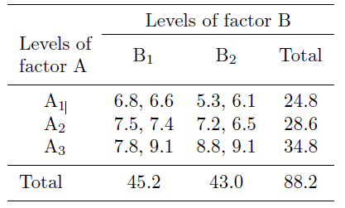
Two factor analysis of variance
Two-factor ANOVA with equal numbers of observations in each subgroup.
Factor A (with J = 3 levels) and factor B (with K = 2 levels) are crossed so that there are JK subgroups formed by all combinations of A and B levels. In each subgroup there are L = 2 observations or replicates.

Slide 18
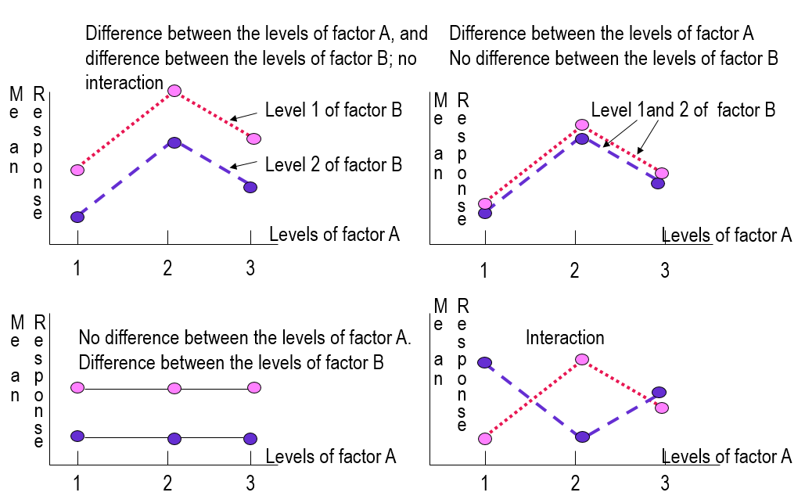

Slide 19
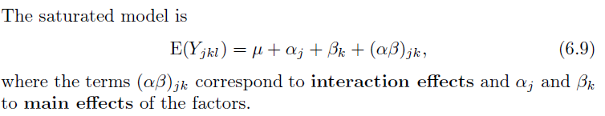
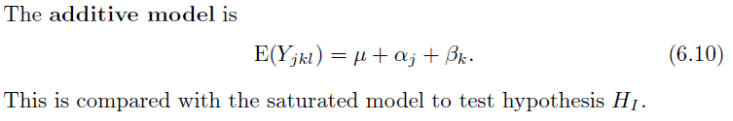
The main hypotheses and the corresponding models:
H_{I} : there are no interaction effects, that is, the effects of A and B are additive

Slide 20
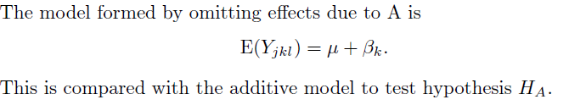
H_{A} : there are no differences in response associated with different levels of
factor A;
Notes:
没有A效应，与additive model比较

Slide 21
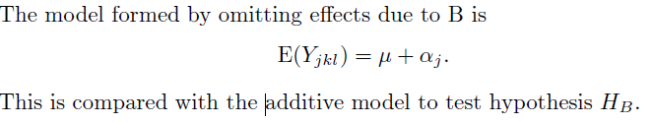
H_{B} : there are no differences in response associated with different levels of
factor B;

Slide 22
Because replicates in the same subgroup have the same expected value so there can be at most JK independent expected values, but the saturated model has 1+J +K +JK = (J + 1)(K + 1) parameters. To overcome this difficulty (which leads to the singularity of X^{T}X), we can impose the extra constraints：
Or
In either case the numbers of parameters are: 1 for μ, J − 1 for the α_{j}’s, K − 1 for the β_{k}’s, and (J − 1)(K − 1) for the (αβ)_{jk}’s, giving a total of JK parameters.
Notes:
Parameter总个数为JK个

Slide 23
ANOVA table for data
Source of variation | Degrees of freedom | Sum of squares | Mean square | F
Treatment A Effect: SSE_{B}-SSE_{Additive} | 2 | 12.7400 | 6.3700 | 25.82
Treatment B Effect: SSE_{A}-SSE_{Additive} | 1 | 0.4033 | 0.4033 | 1.63
Interaction: SSE_{Additive}-SSE_{Saturated} | 2 | 1.2067 | 0.6033 | 2.45
SSE_{Saturated} | 6 | 1.4800 | 0.2467
The value of F =2.45, is not statistically significant compared to the F(2, 6), so the data do not provide evidence against H_{I} .
The value of F =1.63, is not statistically significant compared to the F(1, 6), suggesting that there are no differences due to levels of factor B.
The corresponding test for H_{A} gives F = 25.82, which is significant compared with F(2, 6) distribution. Thus we conclude that the response means are affected only by differences in the levels of factor A.
Notes:
没有interaction；没有b的effect；有a的effect
先看有没有interaction，有interaction不用看单独的a和b的效应，没有interaction再看a和b

Slide 24
Analysis of covariance
Analysis of covariance is the term used for models in which some of the explanatory variables are dummy variables representing factor levels and others are continuous measurements called covariates. As with ANOVA, we are interested in comparing means of subgroups defined by factor levels, but recognizing that the covariates may also affect the responses, we compare the means after “adjustment” for covariate effects.

Slide 25
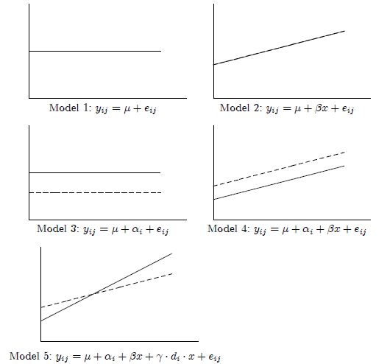

Slide 26
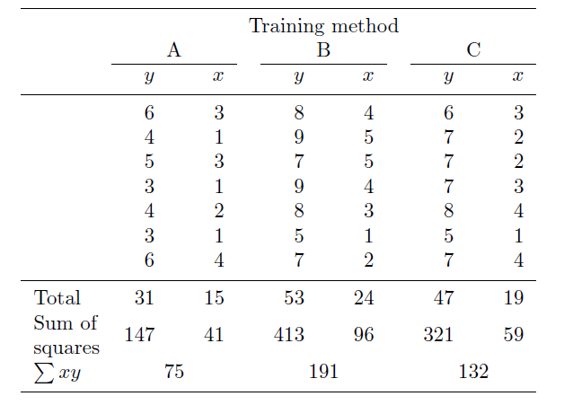
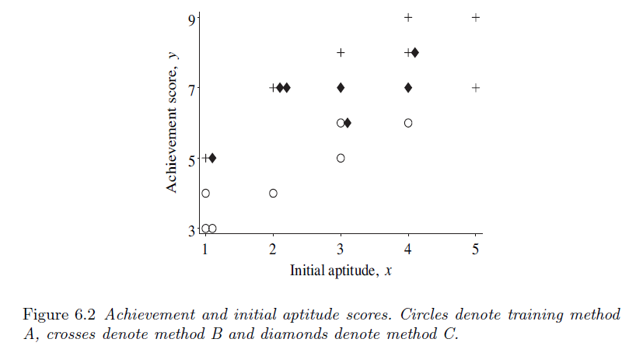
Example
Table: Achievement scores
The responses Y_{jk} are achievement scores measured at three levels of a factor representing three different training methods, and the covariates x_{jk} are aptitude scores measured before training commenced.
We want to compare the training methods, taking into account differences in initial aptitude between the three groups of subjects.

Slide 27
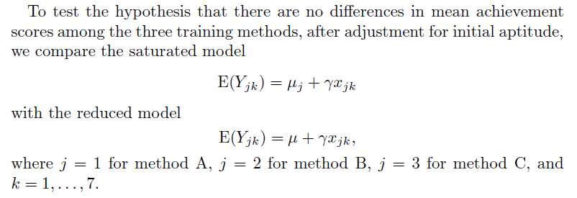
Model Specification

Slide 28
Source of variation | Degrees of freedom | Sum of squares | Mean square | F
Treatment Effect: SSE_{Reduced}-SSE_{Saturated} | 2 | 16.932 | 8.466 | 13.97
SSE_{Saturated} | 17 | 10.302 | 0.606
F =13.97 compared with F(2,17), indicating a significant difference in achievement scores for the training methods, after adjustment for initial differences in aptitude.

